Slide 1
Team Anemone (Group 3)
Ethan Glassman
Ben Hall
Ryan Ward

Slide 2
Objectives:
Maintain local temperature as read by temp. sensor
Ensure safe operating speed of fan
Indicate current wind speed on 3bit display (LEDs)
Challenges:
Synchronizing LEDs proved difficult at first
Threading was a coding challenge
RTD has very little self-heat

Slide 3
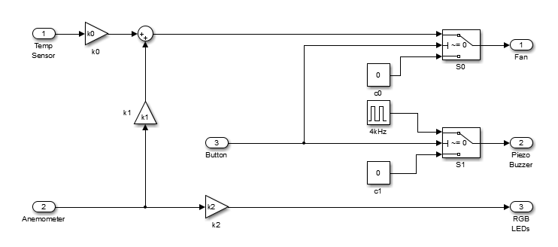
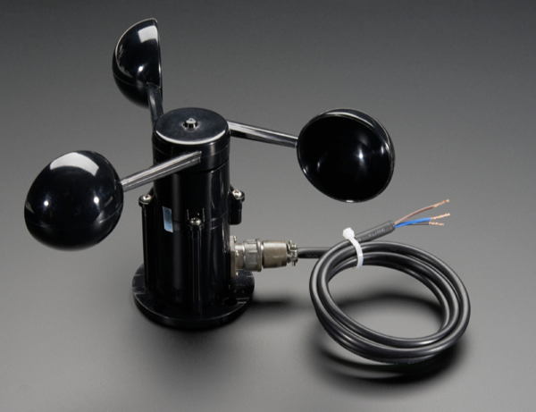
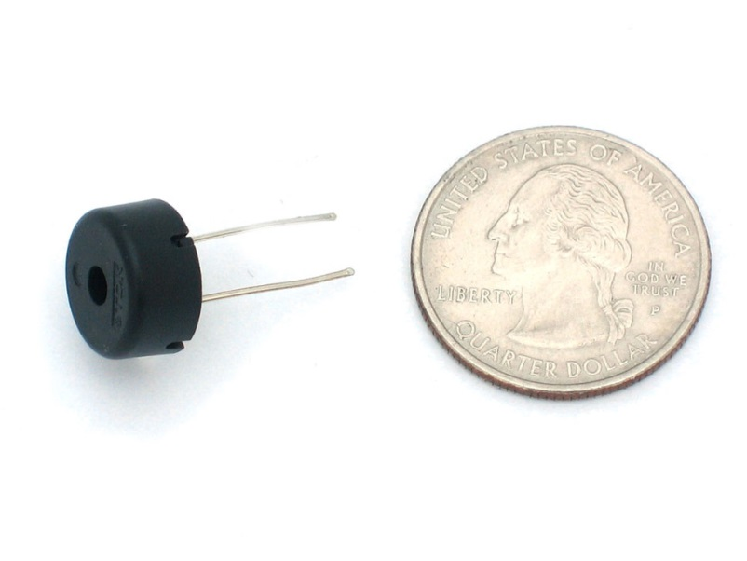

Slide 4
